Slide 1
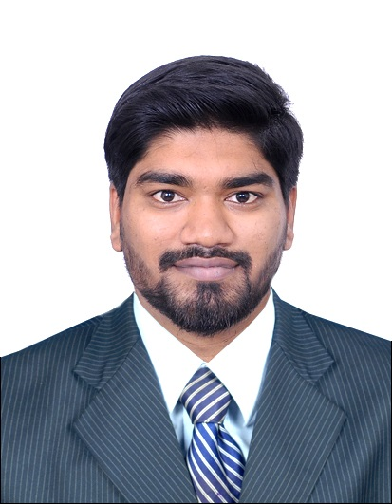
Britto Frangklin Arul Francis
Summary |  |  | Education and Certifications
Senior Project Engineer with a demonstrated history of working in the information technology and services industry with 5 Years of professional experience Business process re-engineering and skilled in ETL Programming, Requirements Analysis, Agile Methodologies [Scrum, Kanban, Scrumban], Xtreme Programming, Scaled Agile framework and Cloud computing services. Product design and development in Web based solutions for Project Management Domain knowledge in Retail Banking North America, Basel Regulatory Compliance, Payment & Card Services and Financial Services |  |  | Strong engineering professional with a Master of Technology (M.Tech.) focused in Software Engineering from BITS, Pilani
 |  |  | AWS Developer Associate Level by Amazon Web Services → November’16 TIC CIU Certified Unix Shell Scriptor by TCCSS → January’17 Big Data Hadoop and Spark Developer by Simplilearn → February’17 IBM Bluemix Cloud Application Developer V2 by Wipro IBM Alliance→ July’17
Professional Skills |  |  | Client Appreciation | Value Adds and Proof of Concepts
Primary Skills | Secondary Skills | Tertiary Skills | Successful Implementation and Constant coordination in Customer Profile process January 21, 2016 “ Great perseverance !! “ -- Kevin Wall, EDS – Card Director “ I want to thank each of you for your constant monitoring and persistence to get this “ -- Tonya Cole , EDS – Card Sr. Manager SnapLogic Demo on EDS Innovation day and took home the award June 24, 2016 “ Congratulations on the EDS innovation for June! Nice Job!! “ -- Tonya Cole , EDS – Card Sr. Manager | Value Adds to Capital One Generic file Converter - EBCDIC TO ASCII and vice versa using Ab Initio PDL Programming Periodic publishing of CC/DL Document updates with problems and solution Web Apps – Wip Cap Initiatives, Cap one Bookmarks, Wip Cap Memories, Wip Cap Olympics Proof of Concepts FTL process for TSYS system on Auth and Trxn CHIPS FTL process through DOCS Framework Data push from S3 Bucket to Red Shift Cluster CHIPS XML Source processing by SnapLogic Data Streaming to S3 bucket and load the same data to Redshift cluster by Apache Ni-Fi CHIPS Process in Symphony Framework
Ab Initio ETL UNIX Shell Scripting Teradata SQL Hadoop Ecosystem | Amazon Web Services HTML/CSS SnapLogic | Apache Ni-Fi Node JS Apache Spark
Leadership Qualities
Trained in leadership programs like ‘Synergy across Teams, Promises-Promises, Ambassador Program’ Proactive contributions and initiatives towards i-Share Sessions Initiated a crew ‘Trend-Setters’ to organize account activities and acting as a focal point for my crew Mentoring my co-workers in all the aspects of domain, functional and technical level Organizing team bonding events periodically such as Potluck, Sport Events, Retro’16, Team Outing’16 Simplifying the management model by developing web apps to leverage project management needs Improvising team agile practices to ensure my team has a proper roadmap on what we are doing Ahead one step on my career growth, acquiring our valuable TLCP Program

Slide 2
Continued ..
Awards | Design and Solutions
‘Thanks A Billion’ by Amit Kolambkar [TL] for building a generic graphs and metric reports for tracing the patterns of competition, strategic orientations, and the differential risk/return profiles associated with various business strategies in the banking industry → April’13 ‘Thanks A Zillion’ by Vasuki Y [PM] for quickly adapting to Agile and contribute significantly to the project success →May’14 ‘Tech Xcellence’ by EDS for consecutive three successful major DDE rollouts in Q2-2015 → Oct’14 ‘Inspiring Performance’ by Vasuki Y [PM] for extraordinary commitment on the work done which is lead to winning Tech Excellence award! → March’15 ‘Tendulkar Cup’ by Heather Foster [PO] and Robert Tresco [SM] for my outstanding performance and exceptional commitment to the Enterprise Data Services (EDS) Card Fraud/Disputes Team → April’15 ‘You Made a Difference’ by Manikantha Tammana [PM] for helping out with "Chennai DR work" and appreciated for organizing team initiatives → Dec’15 ‘Inspiring Performance’ by Deepak Bhat [PM] for going beyond deliverables by taking up extra work assigned to me and ensured that was completed → Dec’15 ‘Best Re-Use of a Technology’ by Tonya Cole [PO] and Robert Tresco [SM] to team for invoking the existing CHIPS process into new SnapLogic technology → June’16 | ACDC Conversion DDE Process → March’15 Conversion of American Express and/or Discover to a Capital One Platinum MasterCard Responsibility: Developer/Maintenance Support Loss of Grace DDE Process → June’15 Bank mustn’t have finance charges on balances for days in prior billing cycles due to the loss of a grace period (i.e., double-cycle billing), unless an exception applies. Charges can be charged on balances during billing cycles when adjusting charges for return of a customer payment or to resolve an unauthorized use. If a customer is not eligible for a grace period, these requirements do not apply. Responsibility: Developer/Maintenance Support | Account Combination DDE Process → May’15 An online servicing tool that allows eligible US Card customers to request to combine cards. If eligible, customers with more than one credit card account can close a card and add the closed card's credit line to one of their other existing credit card accounts. Responsibility: Module Developer/Maintenance Support Customer Profile Feed DDE Process → April’16 Customer profile process provides ability to update customer’s acceptance of terms and conditions for profile-based features such as Credit Tracker and P2P. Provide ability to un-enroll the customer from the profile-based feature Responsibility: Lead Developer/Maintenance Support
 | Key Competency
 | SME in Chordiant and TSYS Systems Techno functional resource Listens effectively to expresses ideas Enthusiastic, proactive and self-starting Independent and self-reliant Effective team player | Comfortable working across business and cultural boundaries Asks for and fulfills challenging, stretch goals Effectively applies learning to new situations Concerned to provide a prompt, efficient and personalized service to clients Understands client's needs and cultivates mutually beneficial client relationships

